Slide 1
Introduction to RNA-seq data analysis
Gladstone Institutes
Krishna Choudhary
Bioinformatics Core, GIDB
October, 2020

Slide 2
Overall goals
Demystify RNA-Seq data analysis
Enable informed conversations with computational biologists
Demonstrate how to analyze data
using a graphical user interface (Galaxy)
IMO: Good for dabbling but not if one needs to analyze large-scale data often
using a command line interface (HPC)
Most computational biologists use the command line
Notes:
This slide deck gives an overview of the tools and tech underlying RNA-seq.
Galaxy is an open source, web-based platform for data intensive biomedical research. There are helpful tutorials to get started with Galaxy on https://usegalaxy.org/.
What is an HPC? https://insidehpc.com/hpc-basic-training/what-is-hpc/

Slide 3
Contents
Introduction
Typical RNA-seq protocol
Different platforms for computing
From sequencer output to count matrix
Tools for today: fastqc, cutadapt, STAR, samtools, featureCounts
File formats: FASTQ, FASTA, BAM/SAM, GFF
Conclusion & Overview of Session 2

Slide 4
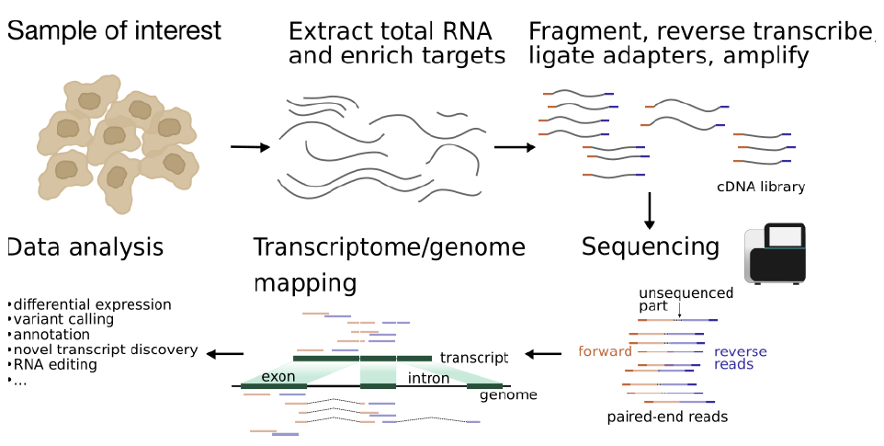
Typical protocol
Notes:
A typical RNA-seq protocol involves collection of biological specimen, isolation of RNA, cDNA library preparation, sequencing the cDNAs to get reads, querying a reference genome for origins of reads and downstream data analysis for differentially expressed genes, novel transcript discovery, etc.

Slide 5


Sequencer
FASTQ
Check quality
Trim adapters
Check quality
Map reads
Check quality
Tally counts
Check quality
DGE analysis
Notes:
Sequencing centers often provide reads in the FASTQ format. The raw reads contain sequences of adapters added during library preparation, which are trimmed to start with. Then, the reads are typically mapped to a reference genome sequence. Counts of reads mapping to genes are tallied and used for differential gene expression analysis. At all stages, it is important to perform quality control of the data. All the tools mentioned in the subsequent slides for these steps are available via the Galaxy platform or can be installed locally. You may have to make an account and login to Galaxy to perform some of the tasks.
All UCSF/Gladstone affiliates can request access to Wynton. Visit https://wynton.ucsf.edu/hpc/get-started/access-cluster.html

Slide 6
Bioinformatics software ecosystem: Tools that “do one thing, and do it well”.
Tools for today: fastqc, cutadapt, STAR, samtools, featureCounts
Available on Galaxy
Some are pre-installed on Wynton; others we can install ourselves
Download a container with all tools installed; use anywhere
Everything can be installed on a laptop
Notes:
Visit https://usegalaxy.org/ and look for these tools in the Tools shed on the left.
Login to a Wynton dev node and search for the tools using module spider

Slide 7
Different platforms for computing

Slide 8
Galaxy provides a collection of tools to analyze variety of biomedical data
https://usegalaxy.org/

Slide 9
Command line interfaces allow scripting
Graphical User Interface
Consists of windows, icons, menus, pointers
Not always available for bioinformatics
Command Line Interface
Text based
Allow automation by scripting
Examples
Wynton CLI
MacOS: Terminal
Windows: Command Prompt, PuTTY

Slide 10
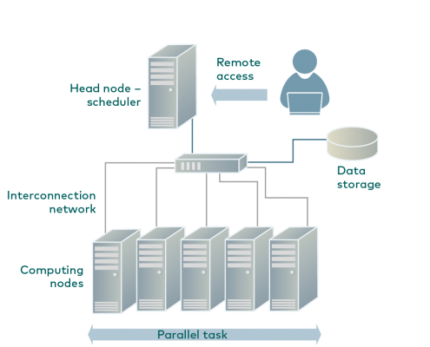
Wynton is a high-performance computing (HPC) system for UCSF affiliates
How to access Wynton? Visit:
https://wynton.ucsf.edu/hpc/get-started/access-cluster.html
Most universities/ institutions doing data-intensive science have HPC cluster on campus.
(see Description for image source)
Notes:
Image taken from https://hpc.rtu.lv/introduction-to-hpc/?lang=en

Slide 11
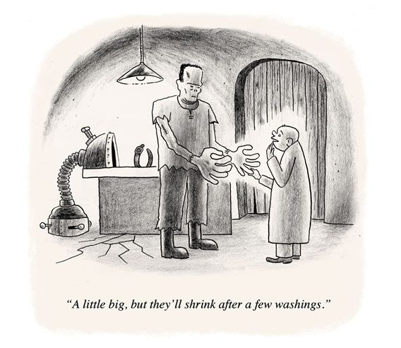
Containers enable reproducibility
Tools are constantly under development
=> Many versions around
Dependencies complicate installations
Dependencies are also constantly under development
=> Many versions around
Different labs use different programming languages

Slide 12
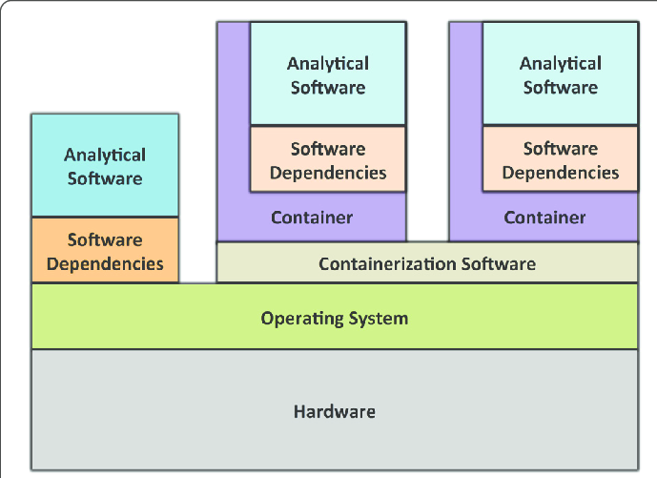
A container is like a computer within a computer
Containerization software examples:
Singularity
Docker (has security issues in the context of HPC)
Containers can be deployed on commercial cloud computing platforms, e.g., Amazon Web Services
(see Description for image source)
Notes:
Image source: https://gigascience.biomedcentral.com/track/pdf/10.1186/s13742-016-0135-4
Paper introducing Singularity: https://journals.plos.org/plosone/article/file?id=10.1371/journal.pone.0177459&type=printable

Slide 13
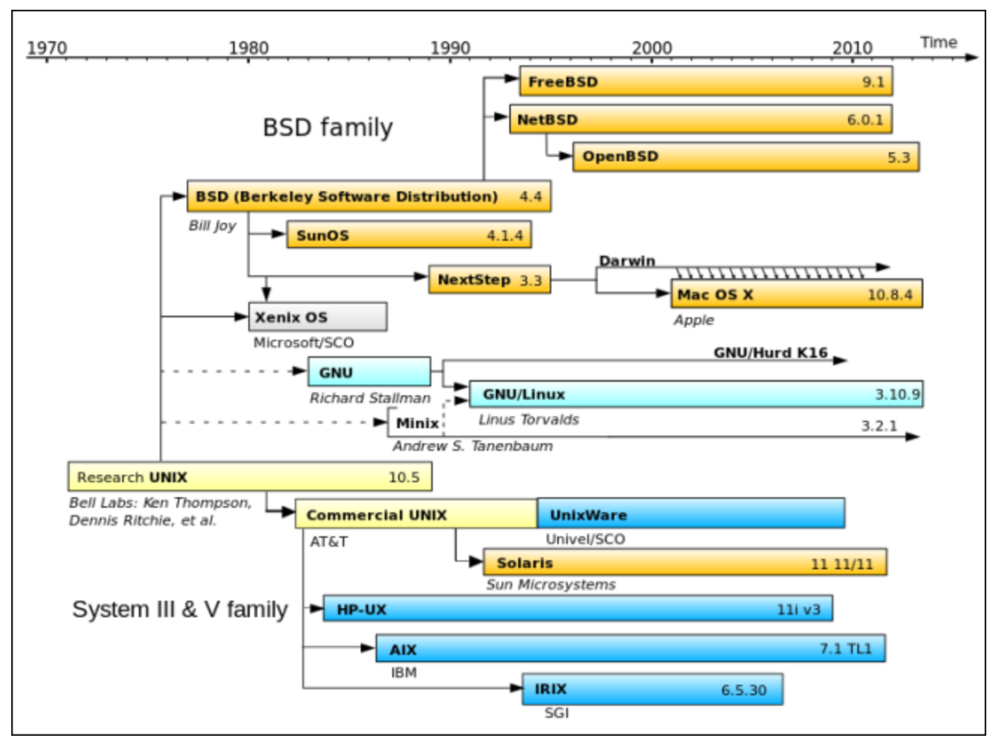
Best to use singularity with Linux (currently)
Limited support for MacOS
Even more limited support for Microsoft Windows
(see Description for image source)
Notes:
Image source: https://www.howtogeek.com/182649/htg-explains-what-is-unix/

Slide 14
Problem definition, shared data files

Slide 15
Problem: identifying differentially expressed genes
Other applications
annotate novel transcriptional events, e.g., exon skipping, alternative 3’ acceptor or 5’ donor sites, intron retention
analysis of genetic variation among expressed genes
RNA editing events
characterization of long noncoding RNAs
…

Slide 16
Experiment design influences data analysis. (should be planned to address relevant questions)
What is the biological question that we seek to answer?
How many tissue types and/or time points to compare?
How deep should we sequence?
Read length?
Which sequencing platform?
Single-end or paired-end?
Pooling?
Biological replicates?
Technical replicates?
Additional considerations?
Not the subject matter today!
Workshop by Reuben Thomas:
Intro to statistics and experimental design.
Reading material:
RNA sequencing data : hitchhiker’s guide
to expression analysis by Berge et al., 2018
Notes:
Before an RNA-seq assay is performed, it is important to carefully consider the experiment design, if necessary in consultation with a statistician. This slide deck does not discuss experiment designs. On our GitHub wiki, we have provided link to a paper that discusses experiment design (Berge et al., 2018). The Gladstone Institute Bioinformatics Core focuses on general principles of experiment design in a separate workshop.

Slide 17
Dataset
Small dataset with 100k reads (for practice only).
FASTQ to tallying counts.
Notes:
Alongside the slide deck, there is a small dataset for a practice analysis. Analysis of real datasets can take time. Real sequenced read libraries can be found online on https://www.ncbi.nlm.nih.gov/sra/.
The practice dataset has a low number of reads, which is not meaningful for differential gene expression analysis. Hence, for differential gene expression analysis use a real counts matrix, an example of which can be found at https://www.ncbi.nlm.nih.gov/geo/query/acc.cgi?acc=GSE49712.

Slide 18
Sequencing centers provide FASTQ files. (~15 min)
Section goal: Understanding origin and contents of FASTQ file type.

Slide 19
cDNA library is applied to a flow cell.
Notes:
Suggested reading: https://bitesizebio.com/13546/sequencing-by-synthesis-explaining-the-illumina-sequencing-technology/

Slide 20
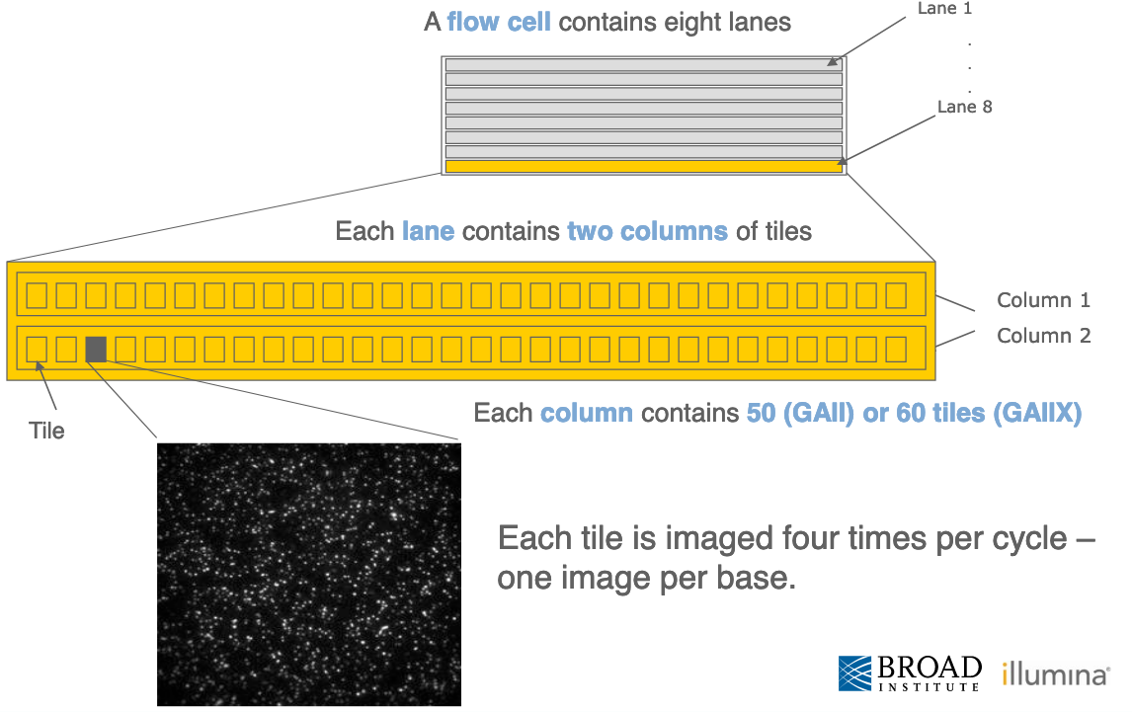
Flow cells are organized in lanes, columns and tiles.
Notes:
Suggested reading: https://www.broadinstitute.org/files/shared/illuminavids/sequencingSlides.pdf

Slide 21
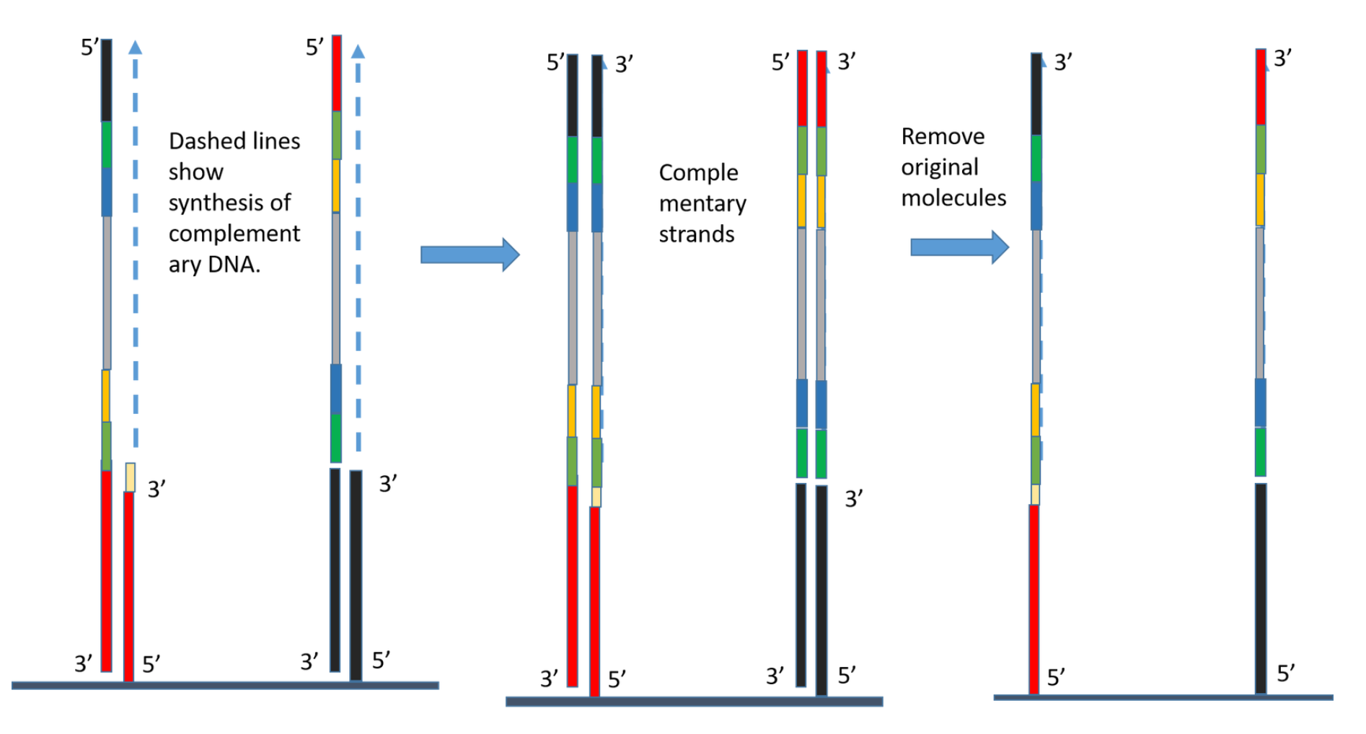
DNA fragments immobilized on flow cell
Notes:
Suggested reading: https://kscbioinformatics.wordpress.com/2017/02/13/illumina-sequencing-for-dummies-samples-are-sequenced/

Slide 22
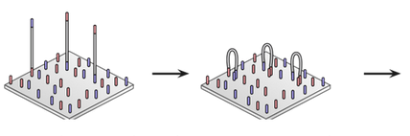
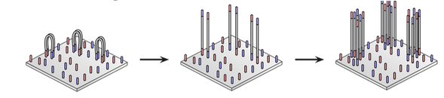
DNA fragments immobilized on flow cell & amplified into clonal clusters.
Synthesize complementary strand
Repeat steps =>
Clonal clusters
Immobilization
Bridging
Linearization
Fragments bend. Adapter on other end pairs with complementary sequence.
cDNA fragments stick to complementary sequences on flow cell.
Notes:
Suggested reading: https://kscbioinformatics.wordpress.com/2017/02/13/illumina-sequencing-for-dummies-samples-are-sequenced/

Slide 23
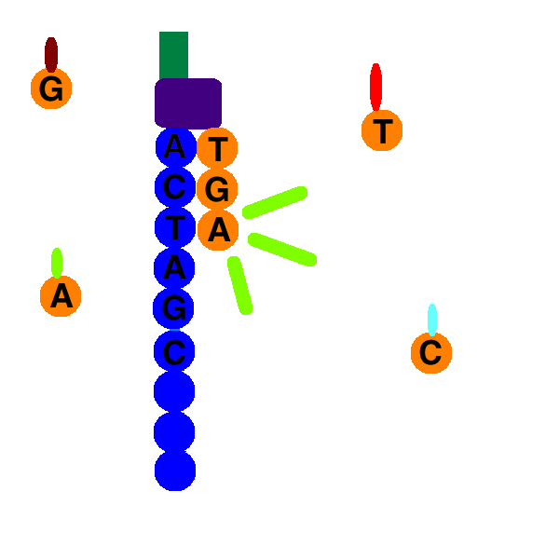
Sequencing by Synthesis
Adapters contain primer binding sites.
Nucleotide with reversible terminator & fluorophore added.
Image nucleotide added.
Remove terminator and fluorophore.
Repeat 2-4.
Notes:
If the cDNA insert from reverse transcribing RNA of interest is short, the sequencing of reads can include reading the adapter sequences.

Slide 24
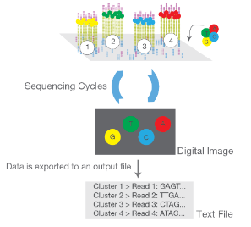
Strong signal from monoclonal clusters.
Notes:
Since all the oligos in a cluster are identical, they give a strong signal with the same color, which can be read by optical devices as a nucleotide.

Slide 25
FASTQ files contain detailed information about each read.
Read sequence.
Instrument used, flow cell id, lane number, tile number, etc.
Quality of each base call.

Slide 26
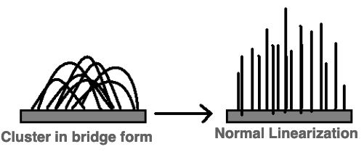
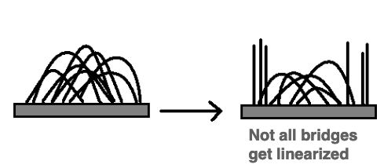
Base calling may not be accurate. Various possible causes: Example
Ideal world
Real world
Notes:
Suggested reading: https://www.broadinstitute.org/files/shared/illuminavids/sequencingSlides.pdf

Slide 27
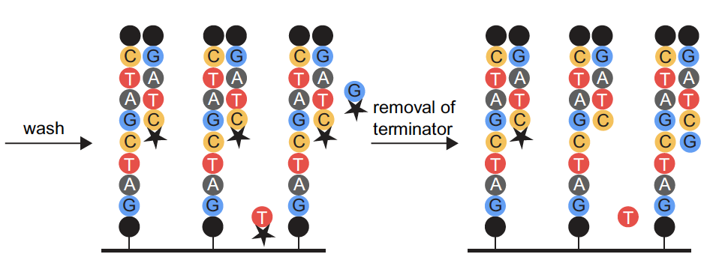
Base calling may not be accurate. Various possible causes: Example
Notes:
Suggested reading: https://www.broadinstitute.org/files/shared/illuminavids/sequencingSlides.pdf

Slide 28
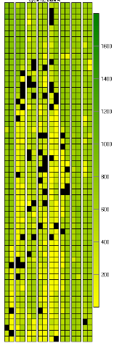
Base calling may not be accurate. Possible causes
Blocking of synthesis after one nucleotide addition may be inefficient.
Clusters might not be monoclonal.
A tile may be out of focus.
Oil, reagent, etc. on flow cell or imaging component, etc.
=> Need to record quality of each base call.
Notes:
Suggested reading: https://www.broadinstitute.org/files/shared/illuminavids/sequencingSlides.pdf

Slide 29
Example FASTQ file with one read only.
Open Single_read.fastq
Notes:
The file is available alongside this slide deck.

Slide 30
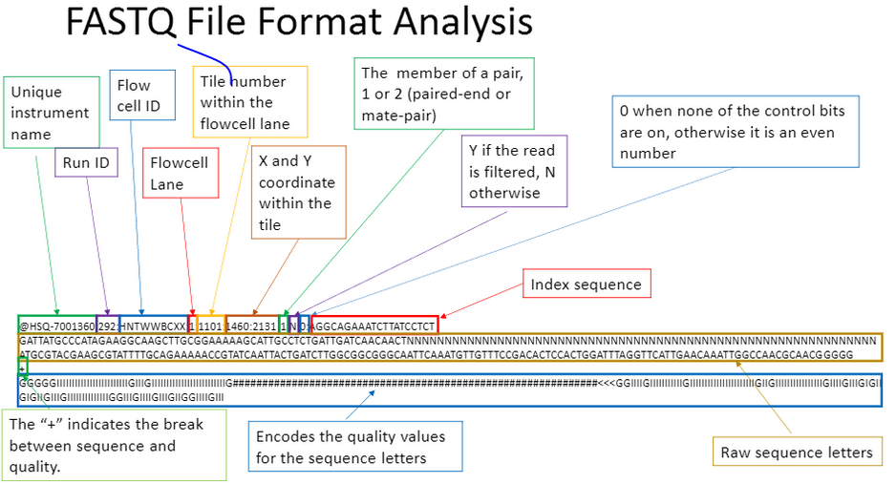
Four lines per read: 1. Read ID, 2. Sequence, 3. Space for optional info, 4. Quality.
Notes:
Suggested reading:
https://kscbioinformatics.wordpress.com/2017/02/13/illumina-sequencing-for-dummies-samples-are-sequenced/
https://help.basespace.illumina.com/articles/descriptive/fastq-files/

Slide 31
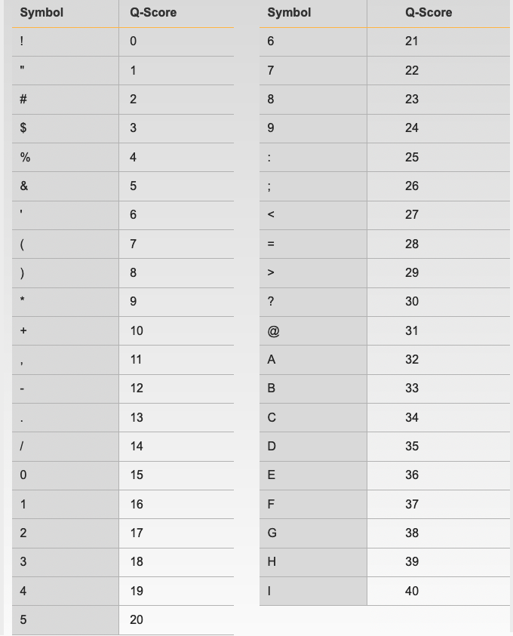
Quality is encoded as symbols.
Quality measured in terms of Phred scores.
Link for Illumina encoding of scores in description.
Notes:
Suggested reading:
https://www.broadinstitute.org/files/shared/mpg/nextgen2010/nextgen_poplin.pdf
https://support.illumina.com/help/BaseSpace_OLH_009008/Content/Source/Informatics/BS/QualityScoreEncoding_swBS.htm

Slide 32
Adapters, primers, contaminants, target sequences, etc. represented in FASTQ files.
Open Bacteria_GATTACA_L001_R1_001.fastq.
Notes:
The file is available alongside this slide deck.

Slide 33
Length of insert < Length of reads ordered => Adapters included in reads.
Notes:
When ordering sequencing of a cDNA library, we specify how many nucleotides of each cDNA fragment must be read. If the length of insert from RNA sample is short, the sequenced reads will include adapter sequences.

Slide 34
Naming conventions for fastq files.
File names often follow a format.
SampleName_Barcode_LaneNumber_ReadNumber_SetNumber.fastq
Ex – Bacteria_GATTACA_L001_R1_001.fastq
Paired-end reads named with R1 and R2 in file name.
Ex – Bacteria_GATTACA_L001_R1_001.fastq and Bacteria_GATTACA_L001_R2_001.fastq
File extensions may be .fq or even .txt.
Often compressed using gzip.
gzip is free and open-source.
Resulting file names have .gz added. Example – .fq.gz.
Notes:
Suggested reading:
https://support.illumina.com/content/dam/illumina-support/documents/documentation/software_documentation/bcl2fastq/bcl2fastq_letterbooklet_15038058brpmi.pdf

Slide 35
Quality control of sequencing files. (~ 30 mins)
Section goal: Running FastQC and interpreting results.

Slide 36
FastQC: Tool for quality control of sequencing data
Summarizes quality of base calls.
Checks for presence of known adapters.
Any sequences more frequently observed than expected?
Any sequence biases?
Any GC biases?
…
Notes:
Suggested reading:
https://rtsf.natsci.msu.edu/genomics/tech-notes/fastqc-tutorial-and-faq/
https://www.bioinformatics.babraham.ac.uk/projects/fastqc/

Slide 37
Galaxy: Open source, web-based platform that integrates many tools.
Free, public, internet accessible resource.
https://usegalaxy.org/
Data transfer and data storage are not encrypted.
DO NOT UPLOAD PROTECTED DATA!!!
For protected or large data:
Setup local galaxy instance.
Run Galaxy on the cloud.
Notes:
1. Go to https://usegalaxy.org/
2. Click on “load your own data” option in the History panel on the right. In the window that opens, click on “Choose local file” and upload Bacteria_GATTACA_L001_R1_001.fastq to Galaxy by selecting it from your computer and pressing “Start”.
3. Search for the FASTQC tool in Galaxy using the Tools panel on the left.
4. Select FastQC from the options.
5. Under the “Short read data from your current history”, our uploaded data should be selected automatically.
6. Click on ”Execute”.
7. Since Galaxy is a freely available tool, it is used by many researchers around the world. It may take some time for the results to be available.
8. When the execution is finished, results will be visible in the History panel. You can view them by clicking on the eye icon next to each resulting file name.
Similar steps of searching for tools in the left panel, viewing the intermediate results by clicking on the eye icon in the right-side History panel, and selecting data files as input in the central panel can be used for subsequent steps.
Suggested reading:
https://galaxyproject.github.io/training-material/topics/introduction/slides/introduction.html#1
https://galaxyproject.github.io/training-material/topics/introduction/

Slide 38
Examples of FastQC reports
Good Illumina data: https://www.bioinformatics.babraham.ac.uk/projects/fastqc/good_sequence_short_fastqc.html
Bad Illumina data: https://www.bioinformatics.babraham.ac.uk/projects/fastqc/bad_sequence_fastqc.html

Slide 39
What if QC gives warn/fail flag?
Non-normal GC content per read?
Normal expected for whole-genome shotgun sequencing.
RNA-seq might give different distributions.
Non-uniform sequence content per nucleotide?
First 10-15 nt in RNA-seq often non-uniform.
High duplication levels or over-represented sequences?
Are they contaminants, e,g. adapers or PCR duplicates?
If so, clean up contaminants.
Could be attributed to highly abundant transcripts.
Are sequence biases expected?
For more: https://rtsf.natsci.msu.edu/genomics/tech-notes/fastqc-tutorial-and-faq/
Notes:
QC goal: Getting a feel of the data. What am I dealing with?

Slide 40
✔️
Sequencer
FASTQ
✔️
Check quality
Trim adapters
Check quality
Map reads
Check quality
Tally counts
Check quality
DGE analysis

Slide 41
Conclusion: Session 1
Bioinformatics software ecosystem: Tools that “do one thing, and do it well”.
Multiple tools are available for the same task.
HPC clusters enable data-intensive science.
Containerization facilitates reproducibility.
Always check “quality” after each step.
Tools and file formats used:
fastqc
FASTQ

Slide 42
Contents: Session 2
Resources for after the workshop
Mapping trimmed reads
cutadapt, STAR or bowtie2, samtools
FASTA, BAM/SAM, GFF
Tallying gene-wise counts
Maybe:
Shell scripting
Submitting jobs to compute nodes
Nextflow

Slide 43
When I need help, which I do need on a daily basis, I visit:
Slack channel for Wynton users
ucsf-wynton.slack.com
http://seqanswers.com/forums/
https://www.biostars.org/
https://www.rna-seqblog.com/
https://stackexchange.com/
Google groups for specific tools
GitHub issues
…

Slide 44
Helpful resources
Wynton slack channel
ucsf-wynton.slack.com
Gladstone Bioinformatics Core slack channel
https://gladstoneinstitutes.slack.com/archives/C0145F1L7QS
Wynton tutorials
https://github.com/ucsf-wynton/tutorials/wiki

Slide 45
How much programming skills do we need for bioinformatics?
Minimum essential
Introductory R
Introductory command line (link to a cheatsheet in speaker notes)
Available at
Gladstone Data Science Training program
Data Science workshops from the UCSF library
https://www.library.ucsf.edu/ask-an-expert/classes-catalog/
For RNA-seq data analysis beyond tallying gene-wise counts:
Intermediate RNA-seq
Pathway analysis
Notes:
https://www.git-tower.com/blog/command-line-cheat-sheet/

Slide 46
Typical command line syntax of bioinformatics tools
$ Toolname –a 10 –b file.txt –c xyz.fq –o pqrs.tuv
$ Toolname --paramA 10 –b file.txt –c xyz.fq –outFile pqrs.tuv
Examples:
$ fastqc –t 16 –o ./ Bacteria_GATTACA_L001_R1_001.fastq
$ fastqc *.fastq
$ cutadapt –a GATTACA –o ./trimmed.fastq input.fastq

Slide 47
Examples of commands to execute various steps
Trimming adapters
$ cutadapt \
> –a file:Adapter_Sequence.fasta \
> –o ./trimmed.fastq Bacteria_GATTACA_L001_R1_001.fastq
Similarly for other tools

Slide 48
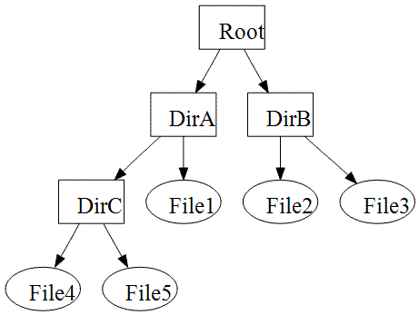
File paths := Location of file on computer
Lots of files on a computer
Organized in directories which may contain sub-directories
Bioinformatics tools may need file inputs and may output files
Where are the input files located on the computer?
Searching entire computer not practical
What if multiple files have the same name?
Where should the output files be saved?

Slide 49
File paths
./ is for current working directory
../ is for parent directory of current working directory
../../ is for parent directory of parent directory of current working directory
/Root/DirA/DirC/File4 is the path of File4 in the image to the right.

Slide 50
Submitting jobs for execution on compute nodes: Same syntax as that for bioinformatics tools
$ qsub -cwd -pe smp 4 -l mem_free=2G -l scratch=50G -l h_rt=00:20:00 script.sh
For details visit:
https://wynton.ucsf.edu/hpc/scheduler/submit-jobs.html

Slide 51
Schedulers maintain a queue of jobs
Many users are submitting jobs to Wynton
Different resource requirements
In what order should the jobs run?
HPC administrators decide which scheduler to use
Popular schedulers
SGE
Slurm
PBS Pro
Notes:
https://hpc-carpentry.github.io/hpc-intro/13-scheduler/index.html

Slide 52
Workflow managers: One command with all required inputs for a pipeline
Examples:
Nextflow
Snakemake
Cromwell
See link in notes for how to run a nextflow pipeline on Wynton
Example usage:
$ nextflow run nf-core/rnaseq \
> --reads '*_R{1,2}.fastq.gz' \
> --genome GRCh37 \
> -profile singularity
Notes:
How to run nextflow on Wynton?
https://github.com/ucsf-wynton/tutorials/wiki/Nextflow-Pipelines
For more on nextflow:
https://sciwiki.fredhutch.org/compdemos/nextflow/

Slide 53
✔️
Sequencer
FASTQ
✔️
Check quality
Trim adapters
Check quality
Map reads
Check quality
Tally counts
Check quality
DGE analysis

Slide 54
Important!
Know the tools you are using
Know what each tool is doing
Know the best practices for analysis
Read benchmarking papers
Read papers providing practical guidelines
Read papers reviewing common practices

Slide 55
Cleaning up contaminants (20 mins)
Section goal: Run cutadapt on fastq files to remove adapters.

Slide 56
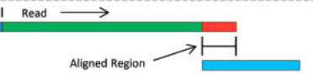
cutadapt removes adapters.
Search for adapter sequence in read.
Allow for mismatches in sequence.
If significant alignment, cut.
Notes:
1. Search for cutadapt in the Tools panel on the left.
2. 3’ prime adapter sequences are available in Adapter_Sequence.fasta. Upload it to Galaxy using the load data icon, which should be visible in the Tools panel at the top. Use this file along with the raw sequence file Bacteria_GATTACA_L001_R1_001.fastq as input to cutadapt on Galaxy.
Suggested reading:
Cutadapt: http://journal.embnet.org/index.php/embnetjournal/article/view/200
Trimmomatic: https://academic.oup.com/bioinformatics/article/30/15/2114/2390096

Slide 57

Alternative approach: Trimmomatic
Say adapter sequence in read is very short.
Can we still identify it?
Yes for paired-end reads.
Primer binding
Adapter
Notes:
Trimmomatic: https://academic.oup.com/bioinformatics/article/30/15/2114/2390096

Slide 58
What else to clean?
PCR primers?
Unique molecular identifiers?
Poor quality base calls?
…

Slide 59
Redo QC to ensure satisfactory quality.
Run FastQC.
Are over-represented sequences gone?
Notes:
Run FASTQC on the fastq file output by cutadapt as described previously.

Slide 60
✔️
✔️
Sequencer
FASTQ
✔️
Check quality
Trim adapters
✔️
✔️
Check quality
Map reads
Check quality
Tally counts
Check quality
DGE analysis

Slide 61
Mapping reads (20 mins)
Section goal: Understand alignment method

Slide 62
Mapping := Aligning reads to regions of reference DNA.
After cleaning, reads from real sample only. (Assumption)
Mapping := Aligning reads to regions of reference DNA.
Challenges:
Reference sequences can be very long (~3 billion bp for humans).
Order of 100 million reads to be mapped.
Need to account for splicing.
Allow for PCR artifacts/sequencing errors.

Slide 63
Inputs needed.
Reads to align.
FASTQ file after cleaning (trimming adapters).
Reference sequence to align to.
Example – “rDNA_sequence.fasta”
FASTA format. Two lines per sequence.
Starting with “>”, followed by sequence name/identifier.
Sequence.
File extensions: .fasta, .fa, .txt.
Notes:
Search for bowtie2 in Tools panel on the left.
Upload rDNA_sequence.fasta to Galaxy using the load data icon, which should be visible in the Tools panel at the top.
Use the output from cutadapt as input under the field “FATA/Q file” in the central panel.
Under “Will you select a reference genome from your history or use a built-in index?” select “Use a genome from history and build index”. Then, select rDNA_sequence.fasta as “the reference genome” in the next field.
Press Execute.
The output should be available as a SAM or BAM file.

Slide 64
Indexing reference sequence speeds up mapping.
Use STAR or bowtie2 to build index.
STAR is popular for RNA-Seq data because it
does unbiased de novo detection of canonical junctions
can discover non-canonical splices
can discover chimeric (fusion) transcripts
Use cleaned reads and index of reference sequence to map.
Notes:
Suggested reading:
https://www.ncbi.nlm.nih.gov/pmc/articles/PMC3322381/pdf/nihms-366740.pdf
https://academic.oup.com/bioinformatics/article/29/1/15/272537
Video lectures on how these mapping tools work:
https://www.youtube.com/watch?v=hpb-mH-yjLc&list=PL2mpR0RYFQsBiCWVJSvVAO3OJ2t7DzoHA

Slide 65
Output => 1. Alignments in SAM format, 2. Summary of mapping statistics.
SAM format:
For each read, mapped where, in what orientation?
Summary statistics:
How many reads mapped?
How many unmapped?
…

Slide 66
Binary Alignment/Map (BAM) format
Alignment reports often very large files.
BAM extension used for compressed SAM files.

Slide 67
Sequence Alignment/Map (SAM) format
Open with Excel.
First few lines contain metadata about alignments.
These lines start with “@”.
Example – version of file format, sorting order of alignments, grouping, etc.
After header, a table of alignments.
Notes:
Suggested reading:
https://samtools.github.io/hts-specs/SAMv1.pdf

Slide 68
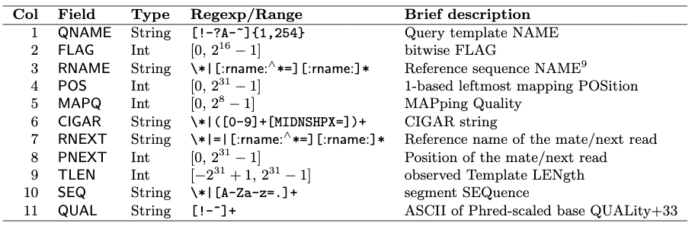
11 fields for each alignment (per row).
Notes:
Suggested reading:
https://samtools.github.io/hts-specs/SAMv1.pdf
https://broadinstitute.github.io/picard/explain-flags.html

Slide 69
Alternatives
Many. Example – bowtie2, BWA, subread, etc.
Differences in speed and memory requirement.
Pros and cons of each:
Example: Some handle spliced alignment, others do not.
…
Notes:
Suggested reading:
https://www.ncbi.nlm.nih.gov/pmc/articles/PMC3322381/pdf/nihms-366740.pdf

Slide 70
Tools to manipulate files are available.
Need to sort alignment report?
samtools
Need to convert FASTQ to FASTA?
fastx-toolkit
…
Google!

Slide 71
✔️
✔️
Sequencer
FASTQ
✔️
Check quality
Trim adapters
✔️
✔️
Check quality
✔️
Map reads
Check quality
✔️
Tally counts
Check quality
DGE analysis

Slide 72
Tally counts (~15 mins)

Slide 73
How many reads overlap annotated regions?
Need annotation information.
Need alignment information.
Use featureCounts.
Notes:
Use the SAM or BAM file from mapping along with as input to featureCounts on Galaxy.
Search for featureCounts in Tools panel.
Upload rDNA.gtf to Galaxy as described before.
Under Alignment file, select the bowtie output.
For Gene Annotation file, select “in your history”.
Then, select rDNA.gtf as the input for Gene Annotation file.
Suggested reading:
https://academic.oup.com/bioinformatics/article/30/7/923/232889

Slide 74
✔️
✔️
Sequencer
FASTQ
✔️
Check quality
Trim adapters
✔️
✔️
Check quality
✔️
Map reads
Check quality
✔️
✔️
Tally counts
Check quality
DGE analysis

Slide 75
Downstream analysis (~15 mins)
No. 1: Differential gene expression analysis.

Slide 76
Gene-wise counts should be normalized before comparing between samples.
Counts can differ because of different library sizes.
Mapping statistics might be different for samples.
Real change in expression level of a gene.
…
Need to factor out differences due to non-biological reasons.
Notes:
Suggested reading:
https://f1000research.com/articles/5-1438

Slide 77
Counts may differ due to inherent noisiness of biological systems.
Identical individuals may give different counts.
Inherent variation used as benchmark to call out interesting variation.
Need to estimate inherent variation or dispersion.
Notes:
Use GSE49712_HTSeq.txt and Sample_metadata_1.txt in edgeR on Galaxy to practice differential analysis.
Better still, work with the data described in https://f1000research.com/articles/5-1438
in R.

Slide 78
✔️
✔️
Sequencer
FASTQ
✔️
Check quality
Trim adapters
✔️
✔️
Check quality
✔️
Map reads
Check quality
✔️
Tally counts
✔️
✔️
Check quality
✔️
DGE analysis

Slide 79
Your feedback is important to us!
https://www.surveymonkey.com/r/RRTZPTC
~3 min.

Slide 80
Conclusions (~5 min)

Slide 81
Topics covered
Steps of analysis.
Common tools, e.g., cutadapt, fastqc, bowtie2, edgeR, etc.
Common file formats, e.g., FASTQ, FASTA, SAM, GFF, etc.
Analysis with Galaxy and Wynton.

Slide 82
Additional information: Sources of data
Sequence read archive
https://www.ncbi.nlm.nih.gov/sra
Download and install SRA toolkit
Step-by-step guide:
https://www.ncbi.nlm.nih.gov/sra/docs/sradownload/#download-sequence-data-files-usi
Consider parallel-fastq-dump if SRA toolkit is too slow

Slide 83
More tools
Quality control: RSeQC, MultiQC, etc.
Mapping: STAR, BWA, etc.
File manipulation: bedtools, samtools, fastx-toolkit, etc.
Visualization: UCSC Genome Browser
…

Slide 84
Upcoming Workshops
Single cell RNA-seq data analysis
Machine Learning

Slide 85
Thank you!

Slide 86
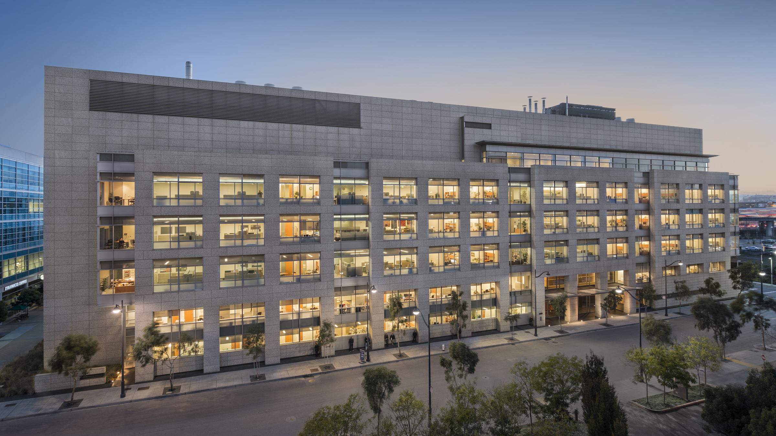
Notes:
This is Gladstone – We were founded 40 years ago and we are a basic biomedical

